Slide 1


MII AUSTRALIA · 2026 COHORT
Online
to Offline
Safely and warmly connecting a seeker
to a local community.
NICK RUNYON · MEDIA IMPACT INTERNATIONAL
Notes:
Welcome. Frame the two days as the entry point to the full MII partnership.

Slide 2
WHERE WE START
He typed six words
into Google.
“How do I save my marriage?”
Two minutes later, a pastor replied.
He was three streets away.
ONLINE TO OFFLINE · DIGITAL PATHWAYS SUMMIT 2026
Notes:
TELL DAVE'S STORY - HOLD THE ENDING. Pay it off at the close.
Dave is a US Army veteran who struggled with PTSD. One night he came home to find his wife had left with the kids - this time for good. Lying on the floor of his empty apartment, staring at the ceiling, he grabbed his phone and Googled 'how do I save my marriage.'
He found a website hosted by a team I was working with, read it, and filled out the form. Two minutes later a pastor connected with him and invited him for coffee. Dave said, 'You don't understand - I'm in Sacramento.' The pastor said, 'I'm right down the street.'
STOP HERE. Do not resolve it. The room should be leaning forward.

Slide 3
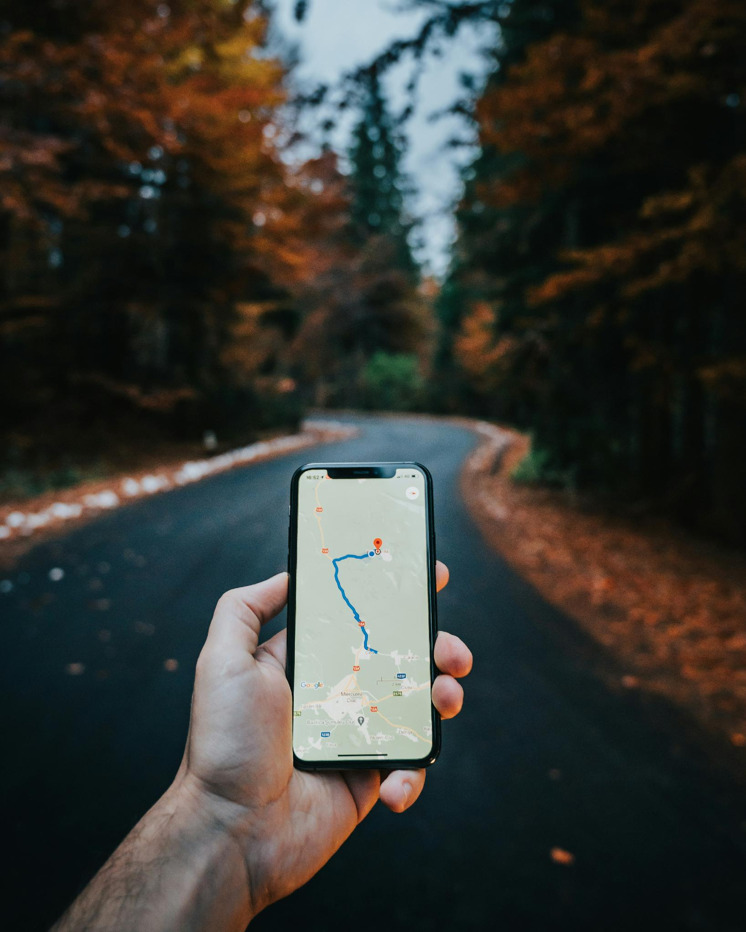
THE BIG IDEA
There are people in your
city, right now, who want
to know Jesus.
They just need some help.
ONLINE TO OFFLINE · DIGITAL PATHWAYS SUMMIT 2026
Notes:
Feeling to create: inspired - this is possible, and it is happening near you.
Dave was not an unusual case. He was a normal man in a normal suburb at the worst moment of his life, and the only place he thought to look was a search bar.
They have real questions and nowhere safe to ask them. Your digital front door is the place that conversation can begin — and your local church is where it should end up.

Slide 4
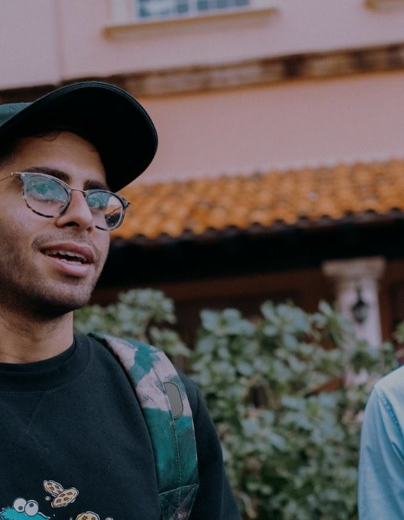

THE BIG IDEA
Let’s build some models
ONLINE TO OFFLINE · DIGITAL PATHWAYS SUMMIT 2026
Notes:
Feeling to create: inspired - this is possible, and it is happening near you.
Dave was not an unusual case. He was a normal man in a normal suburb at the worst moment of his life, and the only place he thought to look was a search bar.
They have real questions and nowhere safe to ask them. Your digital front door is the place that conversation can begin — and your local church is where it should end up.

Slide 5
RETHINKING THE FUNNEL
The Digital Evangelism Ecosystem
01 OUTREACH
DIGITAL EVANGELISM
Searching
Asking AI
Respond to CTA
02 FOLLOW-UP
IN ECHO
Unique
responder
→
Repeat
conversation
→
Hears the
whole gospel
→
Profession
of faith
SHARED HERE
Christian material · Digital Bible - Video Series
03 CONNECTION
LOCAL / NATIONAL / GLOBAL
Online group
or local church
→
Baptism
→
Shares their
own faith
↺
Their story becomes the next person’s search result.
THE SEEKER JOURNEY · DIGITAL PATHWAYS SUMMIT 2026
Notes:
WHY THE OLD FUNNEL IS WRONG - two problems, say both.
1. It starts too late. It opens at 'unique responder', but that is not the beginning of the journey - it is the moment WE first become aware of it. Before that, people spend weeks or months searching, asking AI, reading and watching without ever identifying themselves. By the time someone responds to a call to action, they have already done most of their research. We are joining a conversation that is well underway.
2. It narrows. A funnel draws every stage as loss. But the bottom stages are not people falling out - they are steps of faith taken over time, and they happen in relationship: in an online group, or face to face with a local church. That is depth, not attrition. So the bands here stay the same width.
PHASE 02 is where our follow-up team works, inside ECHO - and where Christian material and Scripture get shared. Phases 01 and 03 are the parts we do not control and too often do not plan for.
THE LOOP is the point: the funnel ends in a point, which implies the story stops. It doesn't. A new believer sharing their faith becomes the content, the testimony and the search result that starts someone else's phase 01.

Slide 6
MODEL 1 - The Church
01 OUTREACH
02 FOLLOW-UP
03 CONNECTION
Digital Evangelism
Follow Up Center
Christian Community
ONLINE TO OFFLINE · DIGITAL PATHWAYS SUMMIT 2026
Notes:
The room is senior pastors, digital and comms staff, and volunteers. Help them see their existing skills and platforms are a path to evangelism - reaching the very people they began this work to reach.
This is where digital ministry becomes actual church. Everything upstream is preparation for this moment.

Slide 7
MODEL 1 - The Church
01 OUTREACH
02 FOLLOW-UP
03 CONNECTION
Digital Evangelism
Follow Up Center
Christian Community
Facebook Campaign
CTA in Online Stream
Prayer Request Campaign
Monday - Saturday Engagement
ONLINE TO OFFLINE · DIGITAL PATHWAYS SUMMIT 2026
Notes:
The room is senior pastors, digital and comms staff, and volunteers. Help them see their existing skills and platforms are a path to evangelism - reaching the very people they began this work to reach.
This is where digital ministry becomes actual church. Everything upstream is preparation for this moment.

Slide 8
MODEL 1 - The Church
01 OUTREACH
02 FOLLOW-UP
03 CONNECTION
Digital Evangelism
Follow Up Center
Christian Community
Facebook Campaign
CTA in Online Stream
Prayer Request Campaign
Monday - Saturday Engagement
Ministry Opportunity for your Congregation
Volunteer as Online Missionary
Be a part of a larger effort
ONLINE TO OFFLINE · DIGITAL PATHWAYS SUMMIT 2026
Notes:
The room is senior pastors, digital and comms staff, and volunteers. Help them see their existing skills and platforms are a path to evangelism - reaching the very people they began this work to reach.
This is where digital ministry becomes actual church. Everything upstream is preparation for this moment.

Slide 9
MODEL 1 - The Church
01 OUTREACH
02 FOLLOW-UP
03 CONNECTION
Digital Evangelism
Follow Up Center
Christian Community
Facebook Campaign
CTA in Online Stream
Prayer Request Campaign
Monday - Saturday Engagement
Ministry Opportunity for your Congregation
Volunteer as Online Missionary
Be a part of a larger effort
Invite to Church
Invite to Bible Study
Invite to Coffee
Connect with Church Partners Elsewhere
ONLINE TO OFFLINE · DIGITAL PATHWAYS SUMMIT 2026
Notes:
The room is senior pastors, digital and comms staff, and volunteers. Help them see their existing skills and platforms are a path to evangelism - reaching the very people they began this work to reach.
This is where digital ministry becomes actual church. Everything upstream is preparation for this moment.

Slide 10
MODEL 2 - Radio Station
01 OUTREACH
02 FOLLOW-UP
03 CONNECTION
Digital Evangelism
Follow Up Center
Christian Community
ONLINE TO OFFLINE · DIGITAL PATHWAYS SUMMIT 2026
Notes:
The room is senior pastors, digital and comms staff, and volunteers. Help them see their existing skills and platforms are a path to evangelism - reaching the very people they began this work to reach.
This is where digital ministry becomes actual church. Everything upstream is preparation for this moment.

Slide 11
MODEL 2 - Radio Station
01 OUTREACH
02 FOLLOW-UP
03 CONNECTION
Digital Evangelism
Follow Up Center
Christian Community
Facebook Campaign
On-air CTA
(e.g. Prayer Request)
Evangelistic Landing Page
Promote Volunteer Opportunity
ONLINE TO OFFLINE · DIGITAL PATHWAYS SUMMIT 2026
Notes:
The room is senior pastors, digital and comms staff, and volunteers. Help them see their existing skills and platforms are a path to evangelism - reaching the very people they began this work to reach.
This is where digital ministry becomes actual church. Everything upstream is preparation for this moment.

Slide 12
MODEL 2 - Radio Station
01 OUTREACH
02 FOLLOW-UP
03 CONNECTION
Digital Evangelism
Follow Up Center
Christian Community
Facebook Campaign
On-air CTA
(e.g. Prayer Request)
Evangelistic Landing Page
Promote Volunteer Opportunity
Trained
Trusted
Transparent
ONLINE TO OFFLINE · DIGITAL PATHWAYS SUMMIT 2026
Notes:
The room is senior pastors, digital and comms staff, and volunteers. Help them see their existing skills and platforms are a path to evangelism - reaching the very people they began this work to reach.
This is where digital ministry becomes actual church. Everything upstream is preparation for this moment.

Slide 13
MODEL 2 - Radio Station
01 OUTREACH
02 FOLLOW-UP
03 CONNECTION
Digital Evangelism
Follow Up Center
Christian Community
Facebook Campaign
On-air CTA
(e.g. Prayer Request)
Evangelistic Landing Page
Promote Volunteer Opportunity
Trained
Trusted
Transparent
Local Church Partners
Online Groups
ONLINE TO OFFLINE · DIGITAL PATHWAYS SUMMIT 2026
Notes:
The room is senior pastors, digital and comms staff, and volunteers. Help them see their existing skills and platforms are a path to evangelism - reaching the very people they began this work to reach.
This is where digital ministry becomes actual church. Everything upstream is preparation for this moment.

Slide 14
MODEL 3 - Para-Church Ministry
01 OUTREACH
02 FOLLOW-UP
03 CONNECTION
Digital Evangelism
Follow Up Center
Christian Community
Facebook Campaign
CTA in Online Stream
Prayer Request Campaign
Landing Page:
Brand Creation
(Campaign)
ONLINE TO OFFLINE · DIGITAL PATHWAYS SUMMIT 2026
Notes:
The room is senior pastors, digital and comms staff, and volunteers. Help them see their existing skills and platforms are a path to evangelism - reaching the very people they began this work to reach.
This is where digital ministry becomes actual church. Everything upstream is preparation for this moment.

Slide 15
MODEL 3 - Para-Church Ministry
01 OUTREACH
02 FOLLOW-UP
03 CONNECTION
Digital Evangelism
Follow Up Center
Christian Community
Facebook Campaign
CTA in Online Stream
Prayer Request Campaign
Landing Page:
Brand Creation
(Campaign)
Training / Onboarding Available for Volunteers
MII Staff Supported
ONLINE TO OFFLINE · DIGITAL PATHWAYS SUMMIT 2026
Notes:
The room is senior pastors, digital and comms staff, and volunteers. Help them see their existing skills and platforms are a path to evangelism - reaching the very people they began this work to reach.
This is where digital ministry becomes actual church. Everything upstream is preparation for this moment.

Slide 16
MODEL 3 - Para-Church Ministry
01 OUTREACH
02 FOLLOW-UP
03 CONNECTION
Digital Evangelism
Follow Up Center
Christian Community
Facebook Campaign
CTA in Online Stream
Prayer Request Campaign
Landing Page:
Brand Creation
(Campaign)
Training / Onboarding Available for Volunteers
MII Staff Supported
National
Church Partners
Online Groups
ONLINE TO OFFLINE · DIGITAL PATHWAYS SUMMIT 2026
Notes:
The room is senior pastors, digital and comms staff, and volunteers. Help them see their existing skills and platforms are a path to evangelism - reaching the very people they began this work to reach.
This is where digital ministry becomes actual church. Everything upstream is preparation for this moment.

Slide 17
PROTECTING QUALITY
REACH
FOLLOW UP QUALITY
Reach and discipleship quality pull
against each other. Plan for it.
ONLINE TO OFFLINE · DIGITAL PATHWAYS SUMMIT 2026
Notes:
Be honest that scale creates volume. Operations talk is welcome here.
The more people you reach, the more disciple-makers you need.
AI analysis preserves follow-up staff time and attention for the people most ready. Qualification gates can be as simple as 'read this passage and let's talk about it.'
BRIDGE LINE: 'The tooling that makes this repeatable at scale is ECHO — the environment Daniel walked you through.' Leave the tech demo to Daniel.

Slide 18
WHY THIS MATTERS TO YOU
You already have
what this takes.
The skills
You already know how to welcome people, listen, and walk with them.
The platforms
You are already publishing. This is the same work, pointed at the people you set out to reach.
This handoff is the hardest step
and the highest-leverage one.
ONLINE TO OFFLINE · DIGITAL PATHWAYS SUMMIT 2026
Notes:
The room is senior pastors, digital and comms staff, and volunteers. Help them see their existing skills and platforms are a path to evangelism - reaching the very people they began this work to reach.
This is where digital ministry becomes actual church. Everything upstream is preparation for this moment.

Slide 19
A NOTE ON RECRUITING ONLINE MISSIONARIES
It takes a process.
And it takes people.
“…to equip his people for works of service, so that the body of Christ may be built up.”
EPHESIANS 4:11–12
Scripture says we are already equipped.
…And, we provide training on platform and best practices
ONLINE TO OFFLINE · DIGITAL PATHWAYS SUMMIT 2026
Notes:
This is the heart of the talk.
A friend recently told me “The church has abandoned me” – What does that actually mean? The church is people, and
The church often feels too cold, too slow and too ill-equipped for this work - but Ephesians says we are all equipped to build the kingdom. Breaking it into Process and People is what makes it actionable rather than aspirational.

Slide 20
PROCESS
Build it with the end in mind.
— Identify local partners early. Engage them from the start, not when the first seeker appears.
— Treat digital as the bridge. Your outreach is how the local community reaches the people best placed to disciple them.
— Design backwards. Start from long-term discipleship and work back to the first click.
A handoff you designed last is a handoff
that will break first.
ONLINE TO OFFLINE · DIGITAL PATHWAYS SUMMIT 2026
Notes:
Identify and engage local ministry partners from the start.
Recognise that digital evangelism efforts are the BRIDGE the local community crosses to connect with the best people to disciple seekers long-term.
Build the whole thing with the end in mind.

Slide 21
SUCCESS
Dave and his whole family
were baptised.
It started with six words typed into a search bar
at the worst moment of his life.
“Discipleship happens in the context of relationship.”
ONLINE TO OFFLINE · DIGITAL PATHWAYS SUMMIT 2026
Notes:
PAY OFF DAVE:
That first Google search - a man on his apartment floor - led to Dave and his wife reconciling and the family moving back in together. They began attending church. A few months later, when we followed up, Dave and his entire family had been baptised and were faithfully attending church.
Land the signature line: 'Discipleship happens in the context of relationship.'
NO Q&A. Go straight into Tim:
'…and that's exactly what Tim from SeeSalt has been living out. Tim — come tell us.'

Slide 23
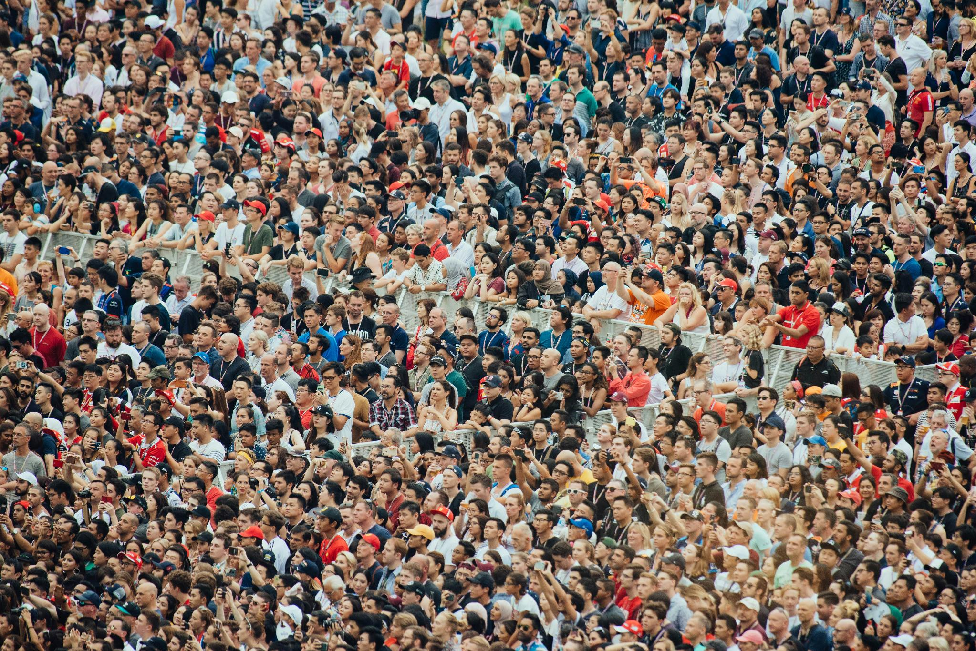
WHY I CARE ABOUT THIS
A billion people reached.
And no way to know
what happened next.
Millions of conversations. No path to a local community.
That gap is what we are here to close.
ONLINE TO OFFLINE · DIGITAL PATHWAYS SUMMIT 2026
Notes:
YOUR AUTHORITY - tell it plainly, not as a boast.
For my first eight years in ministry I served an organisation that reached over a billion people with the gospel - as Director of Outreach and, later, Chief Operating Officer.
I can't think about those years without thinking of the millions who engaged in conversation but had no path to local community connection. We had no way to know whether their time with us was effective, meaningful, or resulted in real spiritual change.

Slide 24
THE DIAGNOSIS
Four ways the handoff breaks.
01
Delay
The seeker waits, and the moment cools.
02
Overload
The team drowns in volume and people slip through.
03
Disconnect
Nobody owns the personal next step.
04
No one to hand to
No local presence has been identified.
ONLINE TO OFFLINE · DIGITAL PATHWAYS SUMMIT 2026
Notes:
Keep the tone personal and diagnostic, not accusatory. Do not do the 'we lost millions' guilt trip.
Every one of these is fixable, and the fix is the rest of this session. Name them with compassion - most people in this room have lived at least two of the four.

Slide 25
PEOPLE
Be normal. Listen well.
Be a guide.
Normal
No “Christian-y” language. Talk like a person.
Listening
Most seekers have never been properly heard on this.
A guide
Every seeker needs someone to help them unlock the mysteries of faith, Jesus and the Bible.
Believers in partnership, each serving the role
they were uniquely equipped for.
ONLINE TO OFFLINE · DIGITAL PATHWAYS SUMMIT 2026
Notes:
Everyone in the process should be normal - no 'Christian-y' language.
Listen well.
Serve as a guide. Every seeker needs a guide to help them unlock the mysteries of faith, Jesus and the Bible.
Together: believers working in partnership to reach their local communities, each serving the role for which they have been uniquely equipped.

Slide 26
HOW TO THINK ABOUT IT
We are not handling leads.
This is closer to matchmaking
than to call-centre support.
We are building lifelong relationships — so the question is never “who takes this ticket?” but “who is the right person for this human being?”
ONLINE TO OFFLINE · DIGITAL PATHWAYS SUMMIT 2026
Notes:
Governing metaphor for the whole session. If they remember one framing, make it this one.
We're not in the business of handling leads - we're building lifelong relationships. This is more matchmaking than call-center support.

Slide 27
THE MOMENT ITSELF
Anatomy of a warm
introduction.
Timing
Move while the seeker is warm.
Consent
The seeker chooses to be introduced.
Context
The local host gets just enough to welcome well.
A small first step
A name, a face, one low-pressure invitation.
ONLINE TO OFFLINE · DIGITAL PATHWAYS SUMMIT 2026
Notes:
Tie back to the Process slide: when local ministry partners are engaged from the beginning, they can focus on carrying the relationship forward - not on 'receiving a lead.'
Consent is the one people skip. Ask the seeker. It changes the whole tenor of the introduction.

Slide 28
SAFEGUARDING
Warmth must never
outrun wisdom.
No personal details
The responder does not share personally identifiable information.
No locations
Teams do not reveal where they are.
Protocols for vulnerable seekers
Followed up under the published policies every ministry should have.
Safety runs on published policy —
not on good intentions.
ONLINE TO OFFLINE · DIGITAL PATHWAYS SUMMIT 2026
Notes:
Keep this section calm and matter-of-fact. It is a credibility slide.
If a ministry in the room does not have published safeguarding policies, this is the thing they should action first - before they scale anything.

Slide 29
ONE-PAGE TAKEAWAY
An ideal online-to-offline
system.
PROCESS
☐ Local partners identified and engaged from the start
☐ Digital positioned as the bridge to local community
☐ Built with the end in mind — discipleship, not a lead
☐ Quality protected as reach grows
PEOPLE
☐ Guides who are normal, listen well, and guide
☐ Warm introductions with timing, consent and context
☐ Safety by published policy
THE ASK
Invite your team and your church into this. It is the mission they signed up for.
ONLINE TO OFFLINE · DIGITAL PATHWAYS SUMMIT 2026
Notes:
Give them a beat to photograph this.
THE ASK: invite your broader team and church members into this exciting ministry opportunity. This is the mission they were called to when they put their faith in Jesus.

Slide 30
SUCCESS
Dave and his whole family
were baptised.
It started with five words typed into a search bar
at the worst moment of his life.
“Discipleship happens in the context of relationship.”
ONLINE TO OFFLINE · DIGITAL PATHWAYS SUMMIT 2026
Notes:
PAY OFF DAVE:
That first Google search - a man on his apartment floor - led to Dave and his wife reconciling and the family moving back in together. They began attending church. A few months later, when we followed up, Dave and his entire family had been baptised and were faithfully attending church.
Land the signature line: 'Discipleship happens in the context of relationship.'
NO Q&A. Go straight into Tim:
'…and that's exactly what Tim from SeeSalt has been living out. Tim — come tell us.'

